Slide 1

Customer Retention Case Study Report
Flip Robo technologies
Prepend By: -
Kishan Sapariya
SME
Khushboo Gurg

Slide 2

Problem Statement
Customer satisfaction has emerged as one of the most important factors that guarantee the success of online store; it has been posited as a key stimulant of purchase or repurchase intentions and customer loyalty.
A comprehensive review of the literature, theories and models have been carried out to propose the models for customer activation and customer retention.
Five major factors that contributed to the success of an e-commerce store have been identified as: Service quality, System quality, Information quality, Trust and Net benefit.
The research furthermore investigated the factors that influence the online customers repeat purchase intention.
The combination of both utilitarian value and hedonistic values are needed to affect the repeat purchase intention (loyalty) positively.
The data is collected from the Indian online shoppers.
Results indicate the e-retail success factors, which are very much critical for customer satisfaction.

Slide 3
Observe all columns data and take output from it.
Columns name | Output Summery
Gender | Female customers has been screened higher than male counterparts (67.28%)
Age | People of age 31-40(30%), 21-30(29.36%), 41-50(26%) has been registered more in online shooping
City | Delhi has seen highest customers in online shopping with 21%
Pincode | Majority buyers are from 201308 pin code
Started Online Shopping | Majority of the people started online shopping 4yrs ago with 36.43%
Online Purchase in Last Year | The frequency of online purchase in last year has remained less than 10times, where as only few of them did shopping more than 42times
Mode of Internet Access | Mobile internet has been the most commonly used mode among the customers gaining more than 70.25% combine
Device | Majority 52% of the people are using Smartphone for online shopping. Laptop is being used by around 32%
Screen Size | Not prefered any screen size for buy online.
OS | People uses Windows/windows mobile 45%. 31.60% people uses Android

Slide 4
Columns name | Output Summary
Browser | 80% of shopping/visitng the web or apps is done by Google Chrome 80.30%
Channel | 85% people prefer search engine. While only 7% each uses marketing and adverts to search for website.
Online Store after first visit | After their visit, most people uses search engine to arrive at website. 32% people uses apps after first attempt both are similar
Time spent before purchase | More than 45% customer invest more than 15mins before making purchases.
Preferred Payment Option | 55% of people prefer credit/debit card as their payment method. 28% uses CoD
Abondon carts items | People discarding cart items sometimes contribute around 63% while only 17% cutomers never discard their cart items.
Reason for abonding carts | 49% customers discard cart due to alterative offer, 20% out of the total people discard because promo code is not applicable. There are 5% people whose preferred mode of payment is not available
Content readability and understanding | More than 60% agree on content understanding and readability
Importance of similar product for comparison | 43 % person strongly agreed
Seller and product information for purchase decision | 38% person are agree and 32% are strongly agreed
Clarity of product information | 49% person are agree and 39% are strongly agreed
Ease of website navigation | More than 90% are satisfied with the ease in website navigation
Loading and processing speed | more than 83% customer are satisfied with loading and processing speed
User friendly Interface of the website | more than 86% are satisfied with website design

Slide 5
Columns name | Output Summary
Convenient Payment methods | Only 11% are disagreeing with convenience in payment method
Trust on finishing transaction by online store at stipulated time | more than 83% trust on transaction being done by online store within time
Assistance with queries | 87% of customers agrees on getting assistance with query
Privacy of customer | 89% customers believe that their privacy is secured
Communication channels | ~
Online shopping gives monetary benefit and discounts | 70% customer believe that online shoppig gives monetary benefit. 18% have indifferent stand to this subject
Enjoyment is derived from shopping online | 52% people enjoy shopping online, 27.88% people have unbiased opinion
Shopping online is convenient and flexible | 82% people agree on shopping online is convenient and flexible
Importance of return and replacement policy | Majority buyers are required return and replacement policy
Gaining access to loyalty programs is a benefit of shopping online | Majority buyers are said it is required.
Customer satisfaction through quality information | 78% customers believe that they gain satisfaction through qualitative info
User satisfaction through good quality website and apps | 96% customers are satisfied with quality of website and apps
User satisfaction through benefit | 82% customers believes that there are monetary savings in online shopping
User satisfaction cannot exist without trust | Majority said user trust is required for next purchase.

Slide 6
Columns name | Output Summary
Offering a wide variety of listed product in several category | Majority said that this is require to choose best product.
Provision of complete and relevant product information | most of buyers are agree with the statement
Monetary savings | Around 82% buyers are said on online shopping monetary savings
The Convenience of patronizing the online retailer | 71% buyers are agree with the statement.
Gives sense of adventure | ~
Enhances social status | Majority of the customers have indefferent opinion that online shopping enhances social status
Feel gratification | ~
Fulfills certain roles | ~
Getting value for money spent | 85% customers agrees on getting value for money spent
Shopped from online retailers | 30% customers shopped from 5 different retailers
Easy to use website or application | 23% buyers are said that Amazon.in, Flipkart.com, Paytm.com, Myntra.com are easy to usefull
Visual appealing web-page layout | 32% are said that Amazon.in, Flipkart.com have nice web page layout.
Wild variety of product on offer | 48% people believes that amazon & flipkart offer wide range of offer on product
Complete, relevant description information of products | 37% said that only Amazon.in, Flipkart.com has provide complete information of products.

Slide 7
Columns name | Output Summary
Loading speed of website and apps | 18% are said that Amazon.in is gain less time for loading webpage
Reliability of the website or application | with this statement 23% buyers are votted in Amazon.in
Quickness to complete purchase | Amazon has the speediest process to complete purchase, then after comes flipkart, Myntra, Paytm and Snapdeal
Availability of several payment options | 24% buyers are said Amazon.in, Flipkart.com provide many payments options.
Speedy order delivery | 69% believes that amazon and flipkart offers speedy delivery
Privacy of customers information | 23% are said that Amazon.in is secured for privacy.
Security of customer financial information | Amazon and flipkart alone has been selected most in terms of financial security.
Perceived Trustworthiness | 28% buyers are said that Amazon.in.
Presence of online assistance through multi-channel | Amazon along with flipkart, myntra & snapdeal has presence of online assistance via multiple channel
Longer time to get logged in (promotion, sales period) | 21% buyers believe that Amazon.in take longer time to logged in.
Longer time in displaying graphics and photos (promotion, sales period) | 22% buyers are said that Amazon.in, Flipkart.com take more time to load images.
Late declaration of price (promotion, sales period) | 28% buyers are said that Myntra.com give late price.
Longer page loading time (promotion, sales period) | 43% buyers are said that Paytm.com and Myntra.comhas take more time.
Limited mode of payment on most products (promotion, sales period) | When it comes to mode of payments, Snapdeal and Amazon are top markers in providing limited platform for payment mode.

Slide 8
Columns name | Output Summary
Longer delivery period | Paytm and Snapdeal is been voted highest in terms of delivery period
Change in website/Application design | For web/apps design, amazon got the highest rating 35%
Frequent disruption when moving from one page to another | 38% buyers are said that Myntra.com and Amazon.in has some issue for webpage
Website is as efficient as before | 35% people believe that amazon is efficient as before, 17% people state that efficinecy of flipkart is intact.
Which of the Indian online retailer would you recommend to a friend? | 29% people would recommend amazon to a friend, 23% would recommend both amazon & flipkart

Slide 9

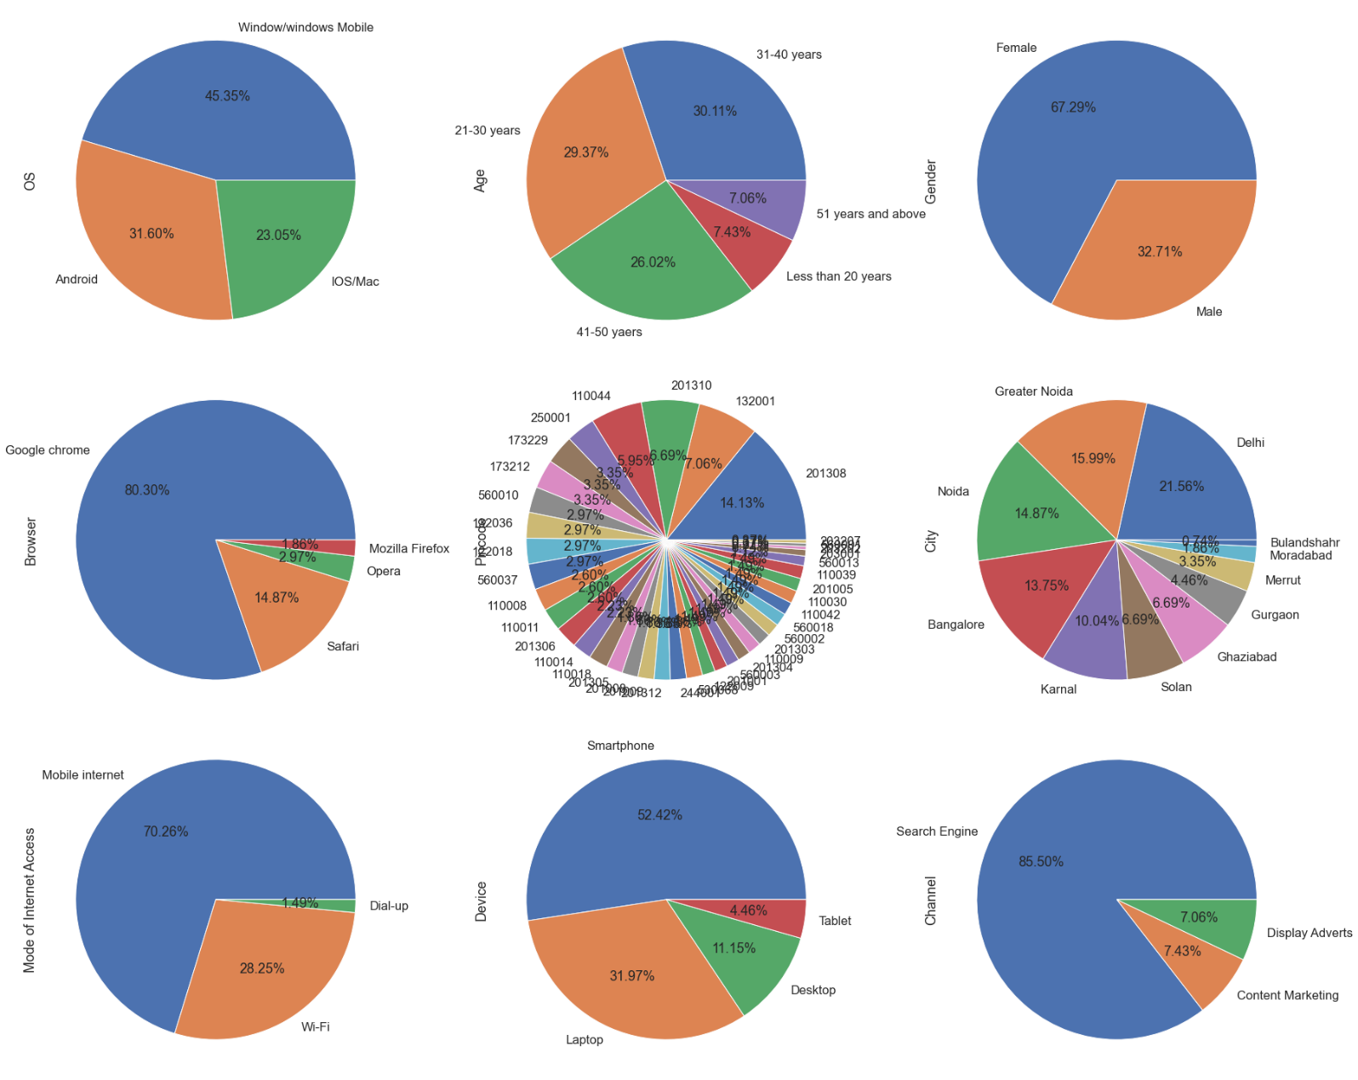
observe data in pie chart as manner to find contribution by its percentage.
As we observe for OS majority of persons are used Website and website mobile.
As we observe for age majority persons are 21- to 40-year-old means young people.
As we observe for Gender majority persons are female around 67.29%.
As we observe for Browser majority public preferred Chrome browser.
As we observe for pin code we clearly observe that most of online shopping around 14.13% are done in 201308 code.

Slide 10
observe data in pie chart as manner to find contribution by its percentage.
As we observe for City majority buyers are from Delhi around 21.56% and Greater Noida around 16%.
As we observe for mode of internet, we observe that majority public use Mobile data for online shopping.
As we observe for Devices which device is preferred by public we observe that majority use Smartphones.
As we observe for Channel, we observe that 86.50% public use Search engine for online shopping.

Slide 11
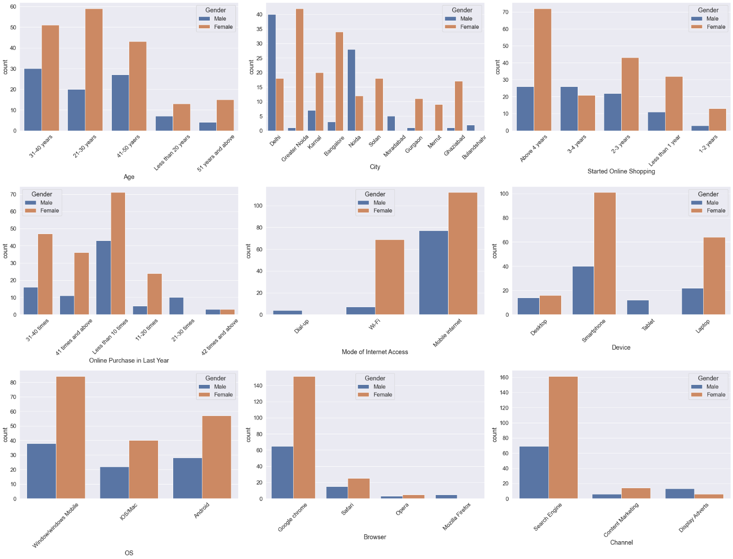
observe data along with Gender
As we observe for Age majority of persons age is between 21-30-year and this is majority of female.
As we observe for Delhi this is only one city which has more number of male compare to females. Also we can say majority of females are is Greater Noida as compare to male.
As we observe for online shopping started majority females are started online shopping Above 4 years and only for 3-4 years has a greater number of males compare to females
As we observe for online purchase in last or previous year we can clearly observe that majority of females are shopped online in last year is less than 10 times.

Slide 12
observe data along with Gender
As we observe for mode of internet preferred for online shopping we observe that no females are use dial up and majority females are use Mobile data and Wi-Fi for online shopping.
As we observe for device usage we can observe that majority females are preferred smart phone and laptop. For tablet zero females are use for online shopping and for desktop it is equal to use by male and female approx.
As we observe for OS majority female usage Windows/Windows mobile and Android.
As we observe for browser male and female both preferred Chrome. And also, no female or zero females are use Mozilla Firefox for online shopping. .

Slide 13
observe data along with Gender
As we observe for Channel majority females are use Search engine and for display advertisement majority males are there in display advertisement.

Slide 14
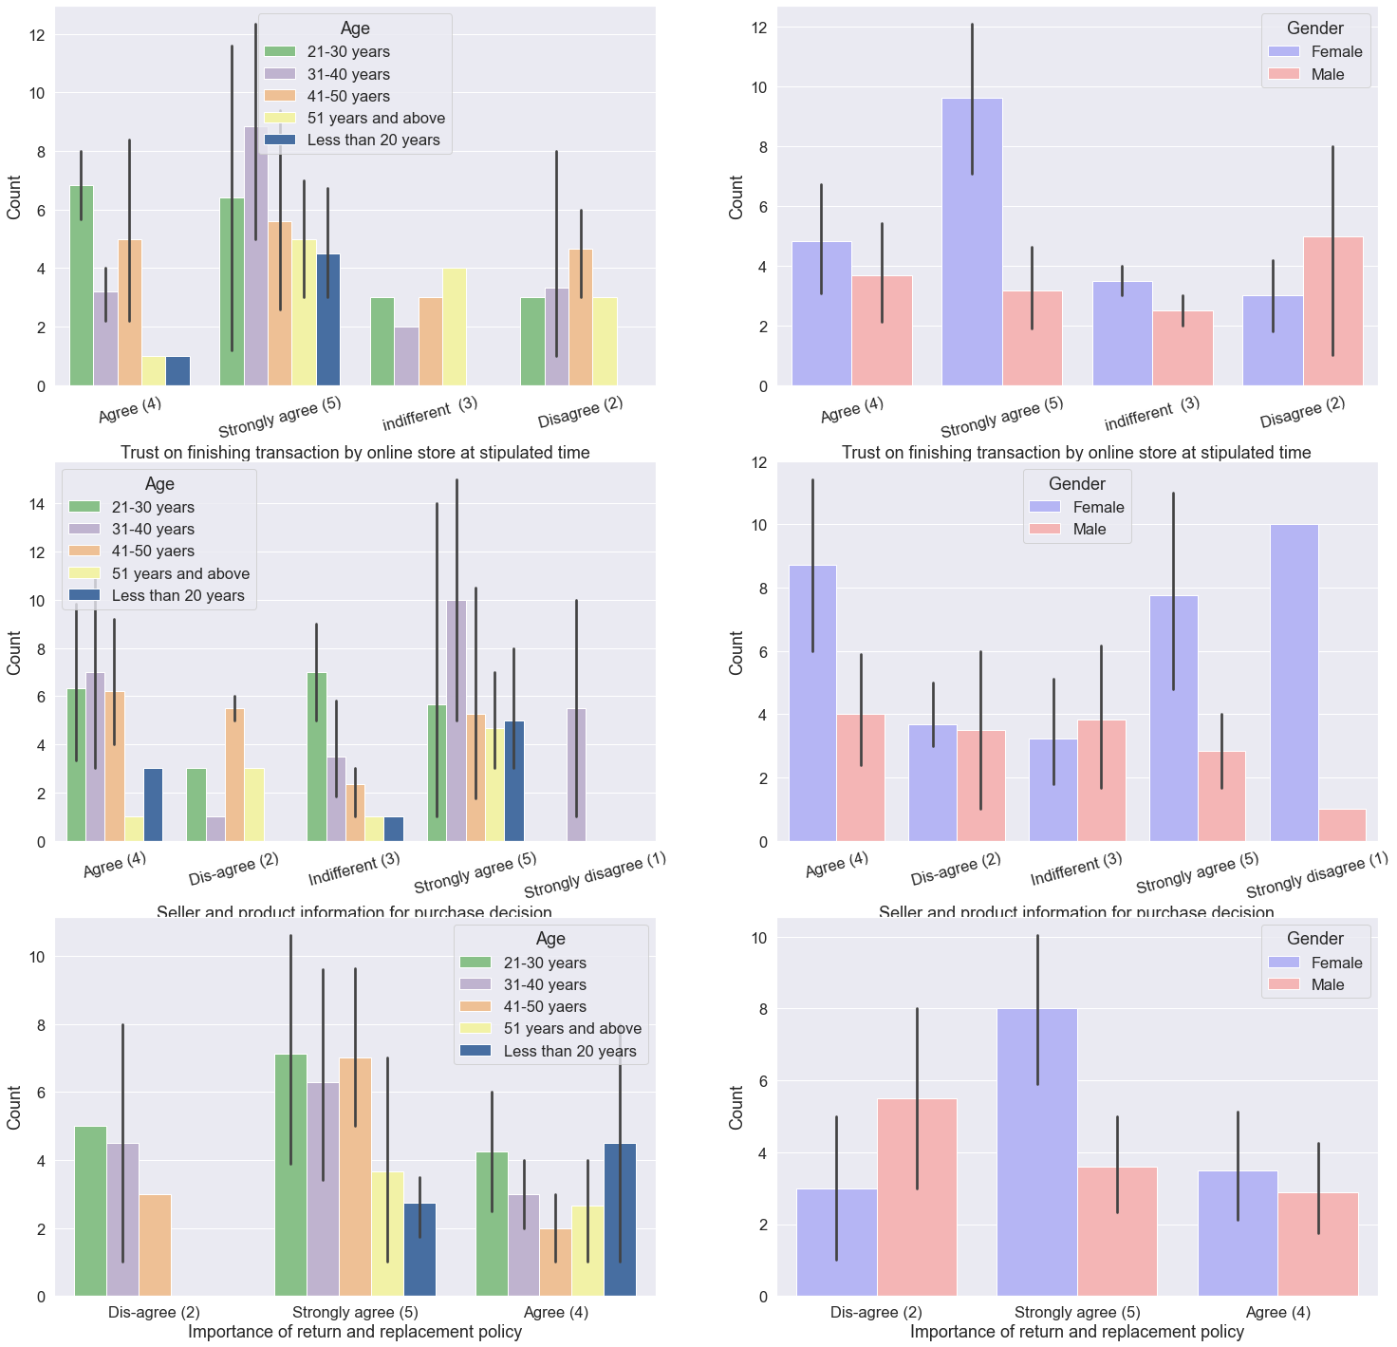
Observe below graphs by age and gender to get more idea about buyers.
As we observe for Trust on finishing transection.
In the age group of 21-30 year’s old they agree to complete transaction on stipulated time we can observe that majority females are trust to complete transaction on time.
In the age group of 31-40 year’s old they are strongly agreeing to complete transaction on stipulated time we can observe that males and females both are equally trust to complete transaction on time.
In the age group of 51 years and above old they are indifferent to complete transaction on stipulated time we can observe that majority males are there.
In the age group of 41-50 year’s old they are not agreeing to complete transaction on stipulated time we can observe that majority males are not trust to complete transaction on time.

Slide 15
Observe below graphs by age and gender to get more idea about buyers.
As we observe for Seller and product information for purchase.
In the age group of 21-50 year’s old they are agreeing to seller and product information are required for purchase we can observe that majority females are agree to this is require.
In the age group of 41-50 year’s old they are Dis-agree to seller and product information are required for purchase we can observe that male and female are equally Dis-agree with statement.
In the age group of 21-30 year’s old they are indifferent to seller and product information are required for purchase we can observe that majority females are indifferent to this is require.
In the age group of 31-40 year’s old they are strongly agreeing to seller and product information are required for purchase we can observe that majority females are strongly agree to this is require.
In the age group of 31-40 year’s old only they are strongly dis-agree to seller and product information are required for purchase we can observe that majority females are strongly dis-agree to this is require.

Slide 16
Observe below graphs by age and gender to get more idea about buyers.
As we observe for Importance of Return and Replacement policy.
In the age group of 21-30 year’s old they are Dis-agree to Importance of Return and Replacement policy are required for purchase we can observe that majority males are Dis -agree to this is required.
In the age group of 21-30 year’s old and 41-50 year’s old they are Strongly agreeing to Importance of Return and Replacement policy are required for purchase we can observe that male and female are agree with statement.
In the age group of less than 20 year’s old they are agreeing to Importance of Return and Replacement policy are required for purchase we can observe that male and female are approximately agree with statement.

Slide 17
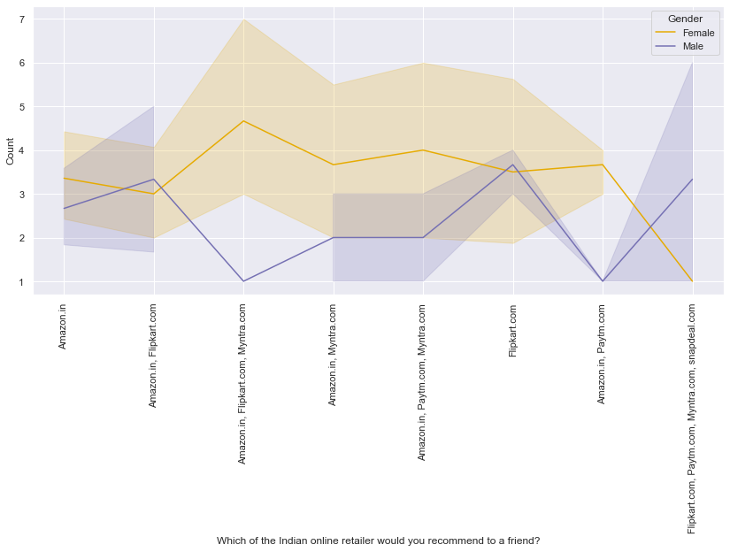
Important to improve this graph

Slide 18

Conclusion

Slide 19

Amazon.com
Require to improve.
During promotions, try to give a disturbance free shopping experience to customers. Like in some time web page error is occurs so, solve it.
Provide more payment options. And also give such a reward with some payments option like Credit card over the COD to reduce it.
Provide price before promotions.
If possible then reduce the delivery time. It is attracting more buyers.
Positive points.
Fast delivery is your most key point.
Website UI/UX is easy to use and simple.
Here, product information is available which is required to the customers.
One of most attracting buyers is online assistance.

Slide 20

Flipkart.com
Require to improve.
During promotions, try to give a disturbance free shopping experience to customers. Like in some time web page error is occurs so, solve it.
Provide more payment options. And also give such a reward with some payments option like Credit card over the COD to reduce it.
Provide price before promotions.
If possible then reduce the delivery time. It is attracting more buyers.
Amazon and Flipkart are almost provided same things to customer do something new to more grow in market.
Positive points.
Fast delivery is your most key point.
Website UI/UX is easy to use and simple.
Here, product information is available which is required to the customers.
One of most attracting buyers is online assistance.
Perceived trustworthiness.
Provide wide variety of each product.

Slide 21

Myntra.com
Require to improve.
During promotions, try to give a disturbance free shopping experience to customers. Like in some time web page error is occurs so, solve it.
Provide more payment options. And also give such a reward with some payments option like Credit card over the COD to reduce it.
Provide price before promotions.
Higher delivery time. This is not good you should reduce it.
Provide wide variety of products.
UI/UX is good but now create more attractive.
Give offer to attract customers.
Positive points.
Here, product information is available which is required to the customers.
Perceived trustworthiness.

Slide 22

Paytm.com
Require to improve.
During promotions, try to give a disturbance free shopping experience to customers. Like in some time web page error is occurs so, solve it.
Provide more payment options. And also give such a reward with some payments option like Credit card over the COD to reduce it.
Provide price before promotions.
Higher delivery time. This is not good you should reduce it.
No males are referred Paytm to his friends for that you have to research for males and give such a offer for male categories.
Positive points.
Quick to complete order.
Very less time to logged in.
Easy to use.
Majority use both website and app.

Slide 23

Snapdeal.com
Require to improve.
During promotions, try to give a disturbance free shopping experience to customers. Like in some time web page error is occurs so, solve it.
Provide more payment options. And also give such a reward with some payments option like Credit card over the COD to reduce it.
Provide price before promotions.
Higher delivery time. This is not good you should reduce it.
No one are referred Snapdeal to his friends for that you have to research for it and give such a offer for male and females.
Do Perfect website UI/UX for easy
Positive points.
Majority are happy because they financial information is secured.

Slide 24
Thank you

